Slide 1
IAS Limited Multi Branch WAN Architecture
Dhaka, Cumilla and Chattogram (CTG): VLAN, DHCP, NAT, BGP, GRE VPN and OSPF

Slide 2
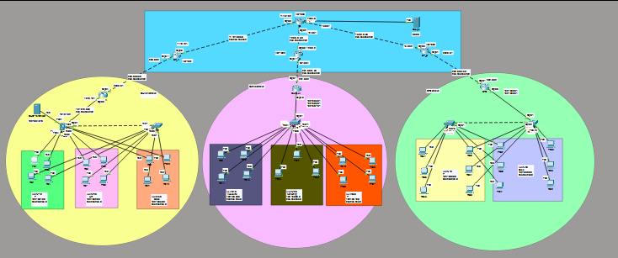
Full Topology :

Slide 3
Project Overview :
Project: We built one connected network for IAS Limited. It joins 3 branches: Dhaka, Cumilla and Chattogram (CTG).
Company need: Each branch needs separate departments (VLANs), automatic IP addresses (DHCP), and internet access.
Size: 3 branches, 5 switches, 3 branch routers, 3 ISP routers and 1 IIG router. 8 department VLANs and 1 DHCP server VLAN.
Our work: VLAN, trunk, inter-VLAN routing, DHCP, NAT (PAT), BGP between ISPs, GRE tunnels, OSPF, SSH and ACL.
Goal: All branches talk to each other safely, and every PC can reach the internet.

Slide 4
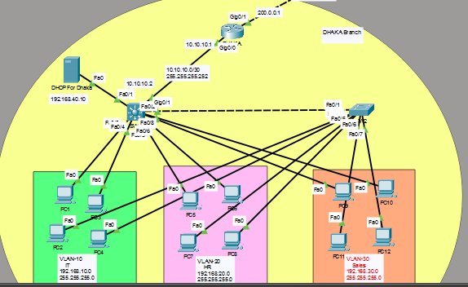
DHAKA BRANCH :
DHAKA
SW1
SW2

Slide 5
Dhaka Branch Work :
Switches: SW1 and SW2 have VLAN 10 (IT), VLAN 20 (HR) and VLAN 30 (Sales). A trunk link joins them.
Gateway: SW1 works as a Layer 3 switch. It gives each VLAN its gateway and routes between VLANs.
DHCP: The DHCP server is in VLAN 40. SW1 uses a helper address, so all PCs get IP addresses automatically.
Router: The DHAKA router connects to SW1 and to ISP_A. NAT (PAT) lets the LANs use the internet.
Extra: Two GRE tunnels go to Cumilla and CTG. OSPF shares routes. An ACL protects the IT VLAN.

Slide 6
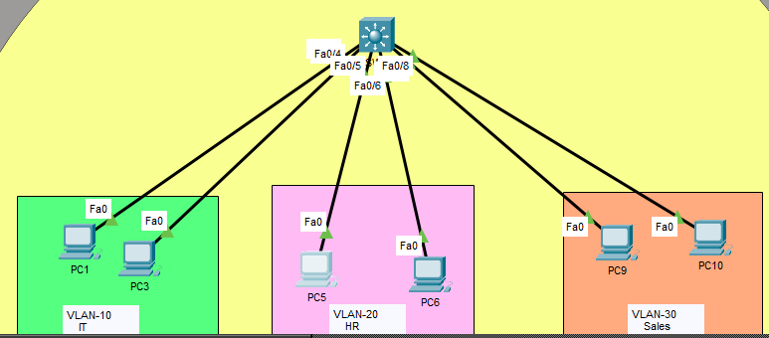
Sw1 Command :
Basic setup: We named the switch SW1 and turned off lookup and console timeout to make working easier.
VLANs: We created VLAN 10 (IT), VLAN 20 (HR), and VLAN 30 (Sales) to keep each department’s network separate.
#Basic Setup :
Switch>enable
Switch#configure terminal
Switch(config)#hostname SW1
SW1(config)#no ip domain-lookup
SW1(config)#line console 0
SW1(config-line)#exec-timeout 0
SW1(config-line)#exit
#Create VLAN 10,20,30 :
SW1(config)#vlan 10
SW1(config-vlan)#name IT
SW1(config-vlan)#exit
SW1(config)#Vlan 20
SW1(config-vlan)#name HR
SW1(config-vlan)#exit
SW1(config)#vlan 30
SW1(config-vlan)#name Sales
SW1(config-vlan)#exit
SW1

Slide 7
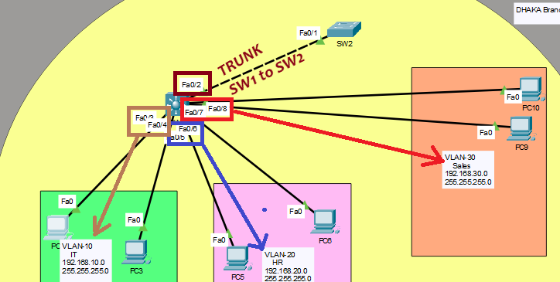
SW1(config)#interface range fastEthernet 0/3-4
SW1(config-if-range)#switchport mode access
SW1(config-if-range)#switchport access vlan 10
SW1(config-if-range)#exit
SW1(config)#interface range fastEthernet 0/5-6
SW1(config-if-range)#switchport mode access
SW1(config-if-range)#switchport access vlan 20
SW1(config-if-range)#exit
SW1(config)#interface range fastEthernet 0/7-8
SW1(config-if-range)#switchport mode access
SW1(config-if-range)#switchport access vlan 30
SW1(config-if-range)#exit
#Set Trunk Port :
SW1(config-if)#interface fastEthernet 0/2
SW1(config-if)#switchport trunk encapsulation dot1q
SW1(config-if)#switchport mode trunk
SW1(config-if)#switchport trunk allowed vlan 10,20,30
SW1(config-if)#exit
SW1
Access ports: Fa0/3-4 go to VLAN 10 (IT), Fa0/5-6 go to VLAN 20 (HR), and Fa0/7-8 go to VLAN 30 (Sales). Now each PC is in its own VLAN.
Trunk port: Fa0/2 is the link from SW1 to SW2. It carries traffic for VLANs 10, 20, and 30 together, so both switches can share the same VLANs.

Slide 8
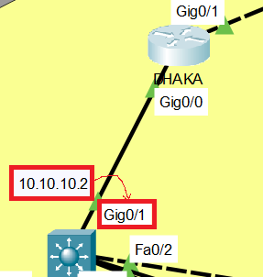
Default gateway: We gave each VLAN an IP address on SW1: 192.168.10.1 (IT), 192.168.20.1 (HR), and 192.168.30.1 (Sales). The PCs in each VLAN will use these as their gateway.
Routing: ip routing turns on routing, so PCs in different VLANs can talk to each other through SW1.
#Config Default Gateway :
SW1(config)#interface vlan 10
SW1(config-if)#no shutdown
SW1(config-if)#ip address 192.168.10.1 255.255.255.0
SW1(config-if)#exit
SW1(config)#interface vlan 20
SW1(config-if)#ip address 192.168.20.1 255.255.255.0
SW1(config-if)#no shutdown
SW1(config-if)#exit
SW1(config)#interface vlan 30
SW1(config-if)#no shutdown
SW1(config-if)#ip address 192.168.30.1 255.255.255.0
SW1(config-if)#exit
#Start Routing in Switch :
SW1(config)#ip routing
#Give ip in Switchport :
SW1(config)#interface gigabitEthernet 0/1
SW1(config-if)#no switchport
SW1(config-if)#ip add 10.10.10.2 255.255.255.252
Router port: We changed Gi0/1 from a switch port to a routed port with the IP 10.10.10.2. This is the link that connects SW1 to router.

Slide 9
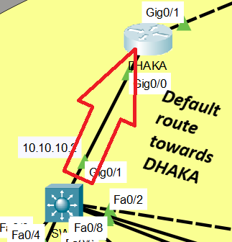
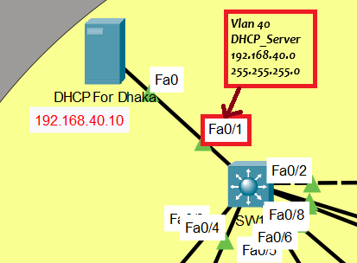
#Default route towards DHAKA:
SW1(config-if)#ip route 0.0.0.0 0.0.0.0 10.10.10.1
#for Dhcp :
SW1(config)#vlan 40
SW1(config-vlan)#name DHCP_Server
SW1(config-vlan)#exit
SW1(config)#interface fastEthernet 0/1
SW1(config-if)#switchport mode access
SW1(config-if)#switchport access vlan 40
SW1(config-if)#exit
SW1(config)#interface vlan 40
SW1(config-if)#no shutdown
SW1(config-if)#ip address 192.168.40.1 255.255.255.0
SW1(config-if)#exit
Default route: Any traffic that SW1 doesn’t know where to send goes to 10.10.10.1, the router toward Dhaka.
VLAN 40: We created a new VLAN called DHCP_Server.
Port Fa0/1: We put this port in VLAN 40, so the DHCP server connects here.
VLAN 40 gateway: We gave it the IP 192.168.40.1, so the server has a gateway.
SW1

Slide 10
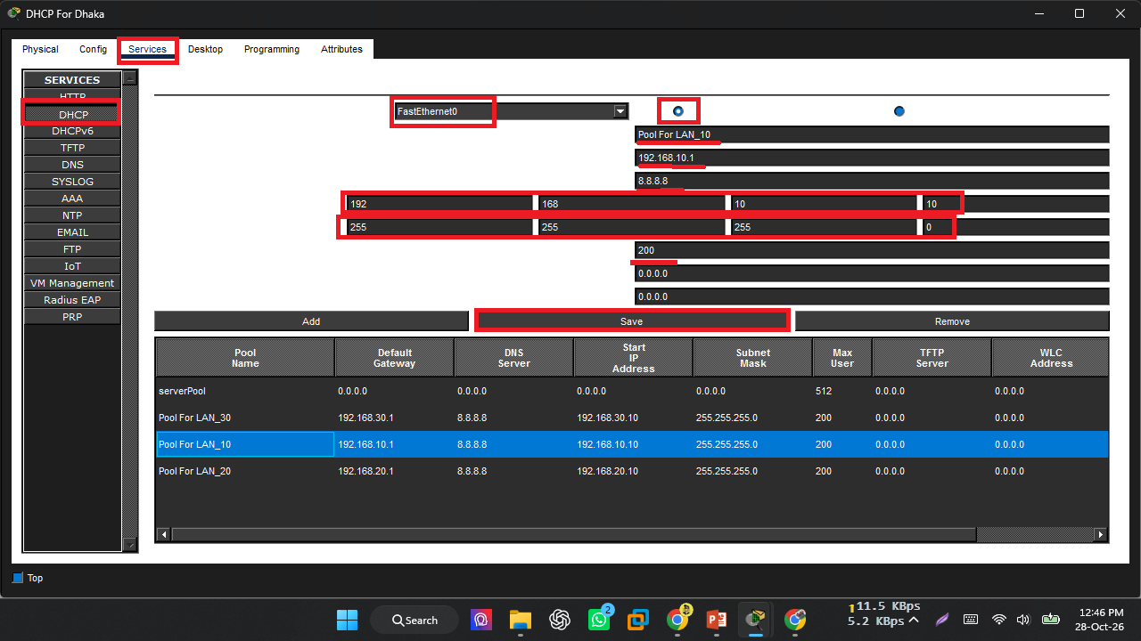
DHCP SERVER SETUP:
Same Process Create pool For Network 192.168.20.0 and 192.168.30.0

Slide 11
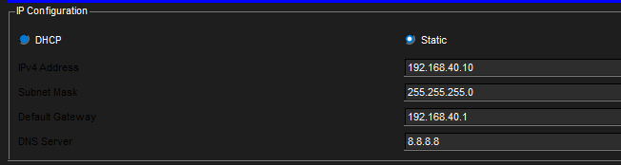
Each pool gives: a default gateway (the SW1 VLAN IP), a DNS server (8.8.8.8), a start IP (.10), a subnet mask, and a max of 200 users.
Result: PCs in each VLAN automatically get their IP, gateway, and DNS from the server.
Static IP: Yes, the DHCP server must have a static IP. Set it to 192.168.40.10 with mask 255.255.255.0 and gateway 192.168.40.1. It must stay fixed because the ip helper-address points to it.

Slide 12
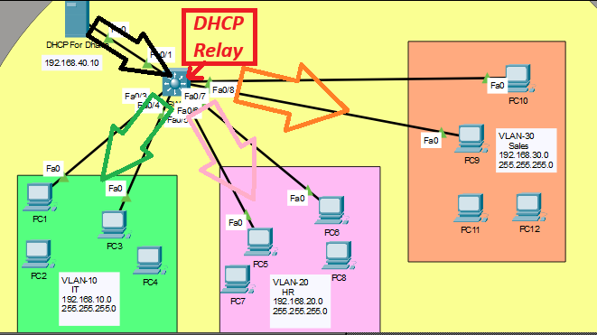
#Dhcp Relay Setup:
SW1(config)#interface vlan 10
SW1(config-if)#ip helper-address 192.168.40.10
SW1(config-if)#exit
SW1(config)#interface vlan 20
SW1(config-if)#ip helper-address 192.168.40.10
SW1(config-if)#exit
SW1(config)#interface vlan 30
SW1(config-if)#ip helper-address 192.168.40.10
SW1(config-if)#exit
Problem: PCs ask for an IP by broadcast, and broadcasts cannot cross VLANs. The DHCP server is in VLAN 40, so it would never hear them.
Fix: ip helper-address 192.168.40.10 makes SW1 catch the request and forward it directly to the DHCP server at 192.168.40.10.

Slide 13
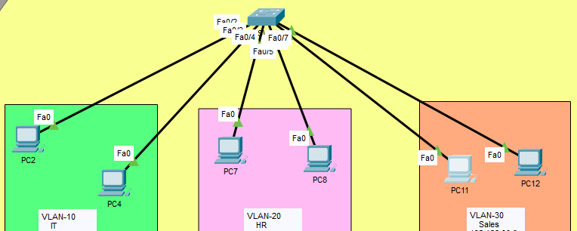
SW2 Command:
Basic setup: We named the switch SW2 and turned off DNS lookup and console timeout.
VLANs: We created VLAN 10 (IT), VLAN 20 (HR), and VLAN 30 (Sales). SW2 must have the same VLANs as SW1
#Basic Setup :
Switch>enable
Switch#configure terminal
Switch(config)#hostname SW2
SW2(config)#no ip domain-lookup
SW2(config)#line console 0
SW2(config-line)#exec-timeout 0
SW2(config-line)#exit
#Create Vlan :
SW2(config)#vlan 10
SW2(config-vlan)#name IT
SW2(config-vlan)#exit
SW2(config)#vlan 20
SW2(config-vlan)#name HR
SW2(config-vlan)#exit
SW2(config)#vlan 30
SW2(config-vlan)#name Sales
SW2(config-vlan)#exit
SW1

Slide 14
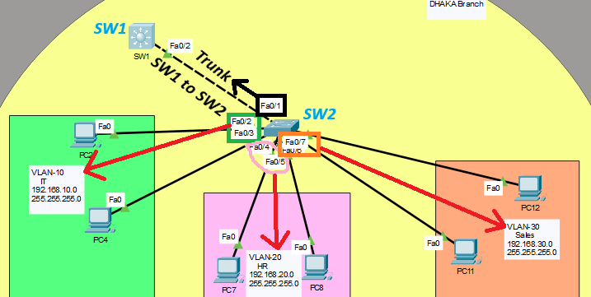
SW2(config)#interface range fastEthernet 0/2-3
SW2(config-if-range)#switchport mode access
SW2(config-if-range)#switchport access vlan 10
SW2(config-if-range)#exit
SW2(config)#interface range fastEthernet 0/4-5
SW2(config-if-range)#switchport mode access
SW2(config-if-range)#switchport access vlan 20
SW2(config-if-range)#interface range fastEthernet 0/6-7
SW2(config-if-range)#switchport mode access
SW2(config-if-range)#switchport access vlan 30
SW2(config-if-range)#exit
#Set Trunk :
SW2(config)#interface fastEthernet 0/1
SW2(config-if)#switchport mode trunk
SW2(config-if)#switchport trunk allowed vlan 10,20,30
Access ports: Fa0/2-3 go to VLAN 10 (IT), Fa0/4-5 go to VLAN 20 (HR), and Fa0/6-7 go to VLAN 30 (Sales). Now each PC on SW2 is in its own VLAN.
Trunk port: Fa0/1 is the link to SW1. It carries VLANs 10, 20, and 30 together, so both switches share the same VLANs

Slide 15
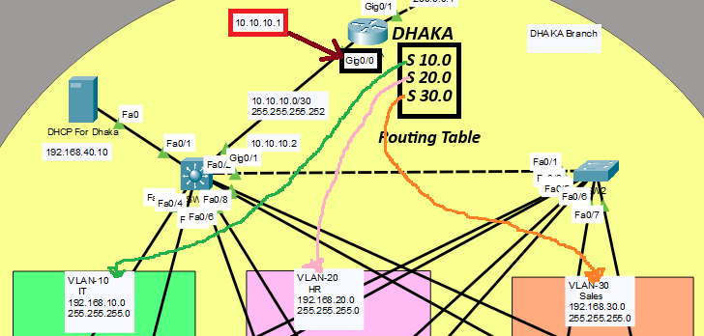
Dhaka Router Command :
#Basic Config :
Router>enable
Router#config terminal
Router(config)#hostname DHAKA
DHAKA(config)#no ip domain-lookup
DHAKA(config)#line console 0
DHAKA(config-line)#exec-timeout 0
DHAKA(config-line)#exit
#Give IP in Interface :
DHAKA(config)#interface gigabitEthernet 0/0
DHAKA(config-if)#no shutdown
DHAKA(config-if)#ip address 10.10.10.1 255.255.255.252
#Set Static route for LAN Network :
DHAKA(config)#ip route 192.168.10.0 255.255.255.0 10.10.10.2
DHAKA(config)#ip route 192.168.20.0 255.255.255.0 10.10.10.2
DHAKA(config)#ip route 192.168.30.0 255.255.255.0 10.10.10.2
Interface: Gi0/0 gets the IP 10.10.10.1. This is the link to SW1 (10.10.10.2), and the /30 mask is perfect for a two-device link.
Static routes: DHAKA now knows that the IT, HR, and Sales networks (192.168.10.0, 20.0, 30.0) are reached through SW1 at 10.10.10.2. Without these, replies from outside would not find their way back to the PCs.

Slide 16
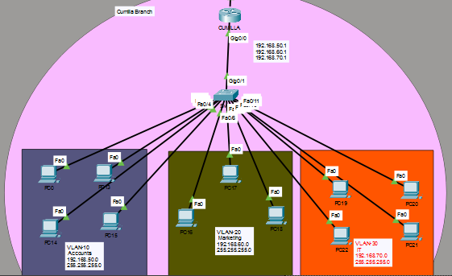
CUMILLA BRANCH:
CUMILLA
SW3

Slide 17
Cumilla Branch Work :
Switch: SW3 has VLAN 10 (Accounts), VLAN 20 (Marketing) and VLAN 30 (IT). Its trunk goes to the router.
Router: The CUMILLA router uses router-on-a-stick. One cable carries all 3 VLANs with 3 sub-interfaces.
DHCP: The router is the DHCP server. Each VLAN has its own pool, and the first IPs are kept for devices.
Internet: NAT (PAT) and a default route to ISP_C give internet access to the branch.
Extra: A GRE tunnel to Dhaka, OSPF, and SSH for safe remote login to the router.

Slide 18
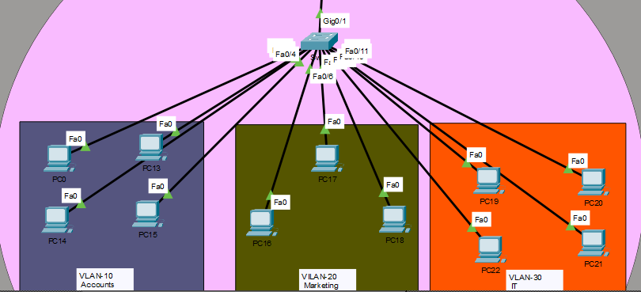
SW 3 Command :
SW3
#Basic Setup :
Switch>enable
Switch#configure terminal
Switch(config)#hostname Sw3
Sw3(config)#no ip domain-lookup
Sw3(config)#line console 0
Sw3(config-line)#exec-timeout 0
#VLAN Create :
Sw3(config)#vlan 10
Sw3(config-vlan)#name Accounts
Sw3(config-vlan)#exit
Sw3(config)#vlan 20
Sw3(config-vlan)#name Marketing
Sw3(config-vlan)#exit
Sw3(config)#vlan 30
Sw3(config-vlan)#name IT
Sw3(config-vlan)#exit
Basic setup: We named the switch Sw3 and turned off DNS lookup and console timeout.
VLANs: We created VLAN 10 (Accounts), VLAN 20 (Marketing), and VLAN 30 (IT). These are for a different site or network,

Slide 19
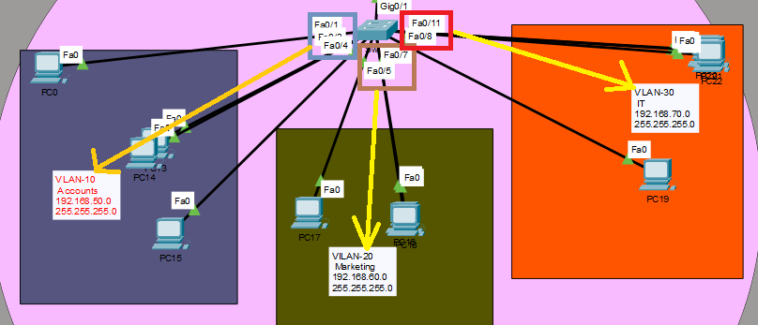
Sw3(config)#interface range fastEthernet 0/1-4
Sw3(config-if-range)#switchport mode access
Sw3(config-if-range)#switchport access vlan 10
Sw3(config-if-range)#interface fastEthernet 0/5-7
Sw3(config-if-range)#switchport mode access
Sw3(config-if-range)#switchport access vlan 20
Sw3(config-if-range)#interface range fastEthernet 0/8-11
Sw3(config-if-range)#switchport mode access
Sw3(config-if-range)#switchport access vlan 30
#Set Trunk Port :
Sw3(config)#interface gigabitEthernet 0/1
Sw3(config-if)#switchport mode trunk
Sw3(config-if)#switchport trunk allowed vlan 10,20,30
Sw3(config-if)#end
Sw3#write
Access ports: Fa0/1-4 go to VLAN 10 (Accounts), Fa0/5-7 go to VLAN 20 (Marketing), and Fa0/8-11 go to VLAN 30 (IT).
Trunk port: Gi0/1 is the uplink. It carries VLANs 10, 20, and 30 together.

Slide 20
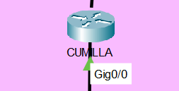
CUMILLA Router Command:
Basic setup: We named the router CUMILLA and turned off DNS lookup and console timeout.
Interface: no shutdown turns Gi0/0 on. It has no IP address yet, which is normal if this port will be split into subinterfaces for the VLANs (router-on-a-stick) toward Sw3.
#Basic Setup :
Router>enable
Router#configure terminal
Router(config)#hostname CUMILLA
CUMILLA(config)#no ip domain-lookup
CUMILLA(config)#line console 0
CUMILLA(config-line)#exec-timeout 0
CUMILLA(config-line)#exit
#Config Interface :
CUMILLA(config)#interface gigabitEthernet 0/0
CUMILLA(config-if)#no shutdown
CUMILLA(config-if)#exit

Slide 21
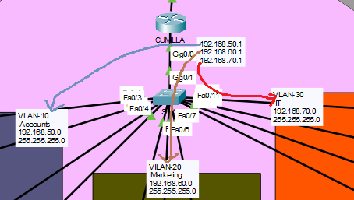
#Create Sub Interface :
CUMILLA(config)#interface gigabitEthernet 0/0.10
CUMILLA(config-subif)#encapsulation dot1Q 10
CUMILLA(config-subif)#ip address 192.168.50.1 255.255.255.0
CUMILLA(config-subif)#exit
CUMILLA(config)#interface gigabitEthernet 0/0.20
CUMILLA(config-subif)#encapsulation dot1Q 20
CUMILLA(config-subif)#ip address 192.168.60.1 255.255.255.0
CUMILLA(config-subif)#exit
CUMILLA(config)#interface gigabitEthernet 0/0.30
CUMILLA(config-subif)#encapsulation dot1Q 30
CUMILLA(config-subif)#ip address 192.168.70.1 255.255.255.0
CUMILLA(config-subif)#exit
Gi0/0.10: encapsulation dot1Q 10 ties it to VLAN 10 (Accounts), and 192.168.50.1 is the default gateway for that VLAN.
Gi0/0.20: Tied to VLAN 20 (Marketing), with gateway 192.168.60.1
Gi0/0.30: Tied to VLAN 30 (IT), with gateway 192.168.70.1

Slide 22
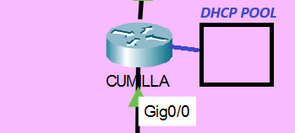
#Dhcp pool for VLAN 10 :
CUMILLA(config)#ip dhcp pool vlan10
CUMILLA(dhcp-config)#network 192.168.50.0 255.255.255.0
CUMILLA(dhcp-config)#default-router 192.168.50.1
CUMILLA(dhcp-config)#dns-server 8.8.8.8
CUMILLA(dhcp-config)#exit
#Dhcp pool for VLAN 20 :
CUMILLA(config)#ip dhcp pool vlan20
CUMILLA(dhcp-config)#network 192.168.60.0 255.255.255.0
CUMILLA(dhcp-config)#default-router 192.168.60.1
CUMILLA(dhcp-config)#dns-server 8.8.8.8
CUMILLA(dhcp-config)#exit
#Dhcp pool for VLAN 30 :
CUMILLA(config)#ip dhcp pool vlan30
CUMILLA(dhcp-config)#network 192.168.70.0 255.255.255.0
CUMILLA(dhcp-config)#default-router 192.168.70.1
CUMILLA(dhcp-config)#dns-server 8.8.8.8
CUMILLA(dhcp-config)#exit
#Exclude IPs:
CUMILLA(config)#ip dhcp excluded-address 192.168.50.1 192.168.50.5
CUMILLA(config)#ip dhcp excluded-address 192.168.60.1 192.168.60.5
CUMILLA(config)#ip dhcp excluded-address 192.168.70.1 192.168.70.5
Pools: vlan10 covers 192.168.50.0/24, vlan20 covers 192.168.60.0/24, and vlan30 covers 192.168.70.0/24. Each pool gives the PCs a gateway (the router’s subinterface IP) and DNS 8.8.8.8.
Excluded addresses: The first five IPs (.1 to .5) in each network are kept out of the pool. They are saved for the gateway and any static devices.

Slide 23
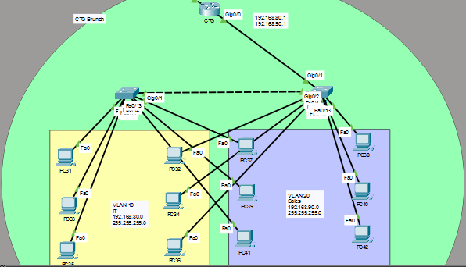
CTG BRANCH:
CTG
SW5
SW4

Slide 24
CTG Branch Work :
Switches: SW4 and SW5 have VLAN 10 (IT) and VLAN 20 (Sales). Both use trunk ports.
Router: The CTG router uses router-on-a-stick with 2 sub-interfaces, one for each VLAN.
DHCP: The router is the DHCP server. Each VLAN has a pool, and the first 20 IPs are kept for devices.
Internet: NAT (PAT) and a default route to ISP_B give internet access to the branch.
Extra: A GRE tunnel to Dhaka and OSPF, so CTG can reach all other branches.

Slide 25
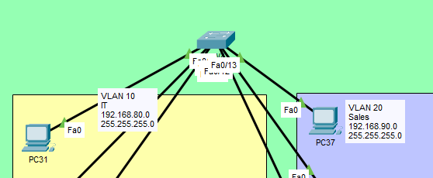
SW4 Command :
#Basic Config :
Switch>enable
Switch#configure terminal
Switch(config)#hostname SW4
SW4(config)#no ip domain-lookup
SW4(config)#line console 0
SW4(config-line)#exec-timeout 0
SW4(config-line)#exit
#Vlan Setup :
SW4(config)#vlan 10
SW4(config-vlan)#name IT
SW4(config-vlan)#exit
SW4(config)#vlan 20
SW4(config-vlan)#name Sales
SW4(config-vlan)#exit
Basic setup: We named the switch SW4 and turned off DNS lookup and console timeout.
VLANs: We created VLAN 10 (IT) and VLAN 20 (Sales). This site has only two VLANs, unlike SW1 and Sw3, which have three.

Slide 26
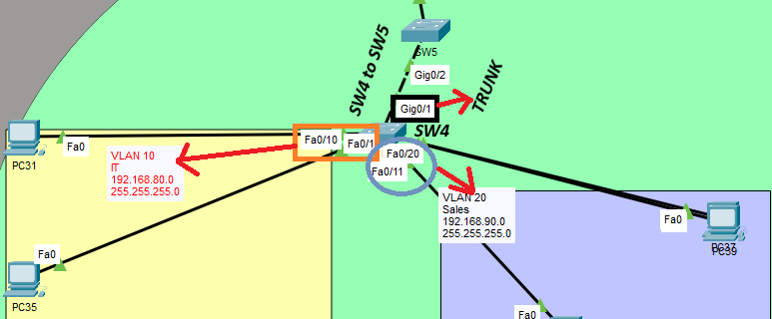
SW4(config)#interface range fastEthernet 0/1-10
SW4(config-if-range)#switchport mode access
SW4(config-if-range)#switchport access vlan 10
SW4(config-if-range)#exit
SW4(config)#interface range fastEthernet 0/11-20
SW4(config-if-range)#switchport mode access
SW4(config-if-range)#switchport access vlan 20
SW4(config-if-range)#exit
#Config Trunk Port :
SW4(config)#interface gigabitEthernet 0/1
SW4(config-if)#switchport mode trunk
SW4(config-if)#switchport trunk allowed vlan 10,20
SW4(config-if)#exit
Access ports: Fa0/1-10 go to VLAN 10 (IT), and Fa0/11-20 go to VLAN 20 (Sales).
Trunk port: Gi0/1 is the uplink. It carries only VLANs 10 and 20 together on one cable.

Slide 27
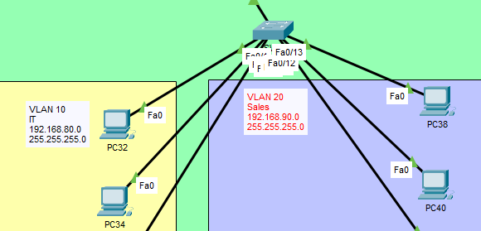
SW5 Command :
SW5
#Basic Setup:
Switch>enable
Switch#configure terminal
Switch(config)#hostname SW5
SW5(config)#no ip domain-lookup
SW5(config)#line console 0
SW5(config-line)#exec-timeout 0
SW5(config-line)#exit
#Vlan Create :
SW5(config)#vlan 10
SW5(config-vlan)#name IT
SW5(config-vlan)#exit
SW5(config)#Vlan 20
SW5(config-vlan)#name Sales
SW5(config-vlan)#exit
Basic setup: We named the switch SW5 and turned off DNS lookup and console timeout.
VLANs: We created VLAN 10 (IT) and VLAN 20 (Sales).

Slide 28
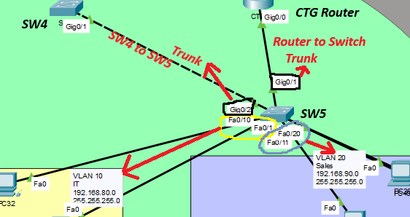
SW5(config)#interface range fastEthernet 0/1-10
SW5(config-if-range)#switchport mode access
SW5(config-if-range)#switchport access vlan 10
SW5(config-if-range)#exit
SW5(config-if-range)#interface range fastEthernet 0/11-20
SW5(config-if-range)#switchport mode access
SW5(config-if-range)#switchport access vlan 20
SW5(config-if-range)#exit
#Config Trunk Port :
SW5(config)#interface gigabitEthernet 0/1
SW5(config-if)#switchport mode trunk
SW5(config-if)#switchport trunk allowed vlan 10,20
SW5(config-if)#exit
SW5(config)#interface gigabitEthernet 0/2
SW5(config-if)#switchport mode trunk
SW5(config-if)#switchport trunk allowed vlan 10,20
SW5(config-if)#exit
Access ports: Fa0/1-10 go to VLAN 10 (IT), and Fa0/11-20 go to VLAN 20 (Sales).
Trunk ports: Gi0/1 and Gi0/2 both carry VLANs 10 and 20.
Gi0/2 link to SW4, Gi0/1 link to the router

Slide 29
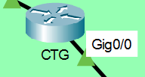
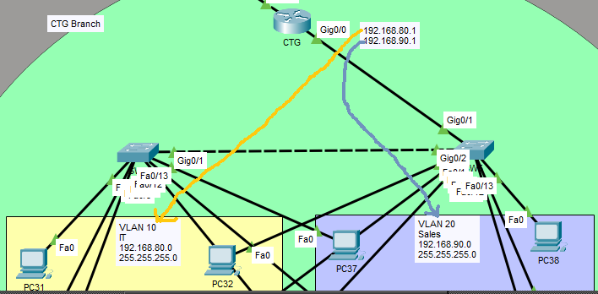
CTG Router Command:
#Basic Setup :
Router>enable
Router#configure terminal
Router(config)#hostname CTG
CTG(config)#no ip domain-lookup
CTG(config)#line console 0
CTG(config-line)#exec-timeout 0
CTG(config-line)#exit
#Interface Setup :
CTG(config)#interface gigabitEthernet 0/0
CTG(config-if)#no shutdown
CTG(config-if)#exit
#Create Sub Interface :
CTG(config)#interface gigabitEthernet 0/0.10
CTG(config-subif)#encapsulation dot1Q 10
CTG(config-subif)#ip address 192.168.80.1 255.255.255.0
CTG(config-subif)#exit
CTG(config)#interface gigabitEthernet 0/0.20
CTG(config-subif)#encapsulation dot1Q 20
CTG(config-subif)#ip address 192.168.90.1 255.255.255.0
CTG(config-subif)#exit
Gi0/0: no shutdown turns the port on. It has no IP itself because the subinterfaces carry the addresses.
Gi0/0.10: Tied to VLAN 10 (IT), with gateway 192.168.80.1.
Gi0/0.20: Tied to VLAN 20 (Sales), with gateway 192.168.90.1.

Slide 30
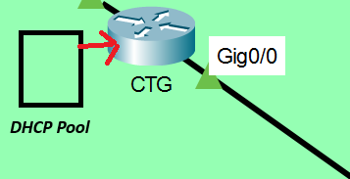
#Dhcp For VLAN 10 :
CTG(config)#ip dhcp pool vlan10
CTG(dhcp-config)#network 192.168.80.0 255.255.255.0
CTG(dhcp-config)#default-router 192.168.80.1
CTG(dhcp-config)#dns-server 8.8.8.8
CTG(dhcp-config)#exit
#Dhcp For VLAN 20 :
CTG(config)#ip dhcp pool vlan20
CTG(dhcp-config)#network 192.168.90.0 255.255.255.0
CTG(dhcp-config)#default-router 192.168.90.1
CTG(dhcp-config)#dns-server 8.8.8.8
CTG(dhcp-config)#exit
#Dhcp Exclude Ips :
CTG(config)#ip dhcp excluded-address 192.168.80.1 192.168.80.20
CTG(config)#ip dhcp excluded-address 192.168.90.1 192.168.90.20
Pools: vlan10 covers 192.168.80.0/24 and vlan20 covers 192.168.90.0/24. Each pool gives the PCs a gateway (the subinterface IP) and DNS 8.8.8.8.
Excluded addresses: The first 20 IPs (.1 to .20) in each network are kept out of the pool. They are saved for the gateway and static devices like servers or printers. PCs will start getting IPs from .21.

Slide 31
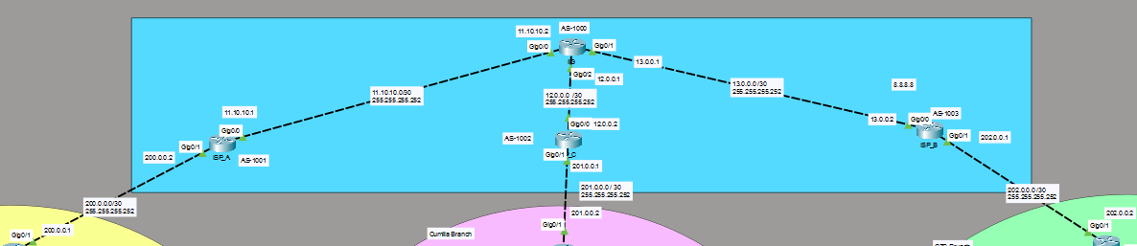
Internet
IIG
ISP_C
ISP_A
ISP_B
The internet part has 4 routers: IIG, ISP_A, ISP_B and ISP_C.
IIG is in the center. It connects to all three ISPs.
ISP_A connects to the Dhaka branch, ISP_C connects to the Cumilla branch, and ISP_B connects to the CTG branch.
Each link uses a small /30 network (for example, 11.10.10.0/30 for IIG to ISP_A).
The routers use BGP to share routes: IIG is AS 1000, ISP_A is AS 1001, ISP_C is AS 1002 and ISP_B is AS 1003.
Each branch uses NAT (PAT), so all private PCs go out with one public IP: 200.0.0.1 (Dhaka), 201.0.0.2 (Cumilla) and 202.0.0.2 (CTG).

Slide 32
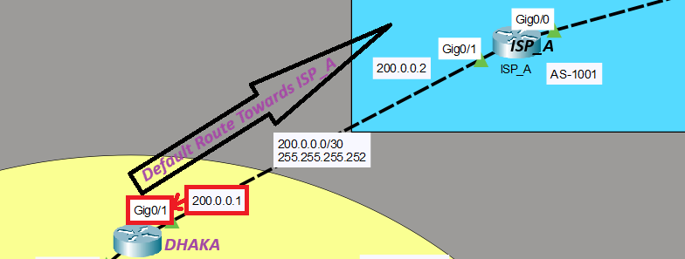
DHAKA Router Command:
Gi0/1: We turned it on and gave it the IP 200.0.0.1 with a /30 mask. This is the link to ISP_A, whose side will be 200.0.0.2.
Default route: Any traffic DHAKA doesn’t know where to send goes to 200.0.0.2 (ISP_A). This is how your LANs will reach the internet or other sites.
DHAKA#conf ter
DHAKA(config)#interface gigabitEthernet 0/1
DHAKA(config-if)#no shutdown
DHAKA(config-if)#ip address 200.0.0.1 255.255.255.252
DHAKA(config-if)#exit
#Default Route Towards ISP_A
DHAKA(config)#ip route 0.0.0.0 0.0.0.0 200.0.0.2

Slide 33
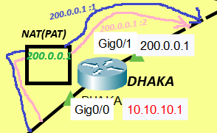
ACL 10: It lists the networks allowed to use NAT: 192.168.10.0, 20.0, and 30.0 (IT, HR, Sales)
NAT pool: natp1 has only one public IP, 200.0.0.1, which is DHAKA’s own Gi0/1 address.
#Config NAT(PAT)
DHAKA(config)#access-list 10 permit 192.168.10.0 0.0.0.255
DHAKA(config)#access-list 10 permit 192.168.20.0 0.0.0.255
DHAKA(config)#access-list 10 permit 192.168.30.0 0.0.0.255
DHAKA(config)#ip nat pool natp1 200.0.0.1 200.0.0.1 netmask 255.255.255.252
DHAKA(config)#ip nat inside source list 10 pool natp1 overload
#Apply NAT In interFace
DHAKA(config)#interface gigabitEthernet 0/0
DHAKA(config-if)#ip nat inside
DHAKA(config-if)#exit
DHAKA(config)#interface gigabitEthernet 0/1
DHAKA(config-if)#ip nat outside
DHAKA(config-if)#exit
Overload: overload is what makes it PAT. Many PCs share that one public IP, and the router tells them apart by port numbers.
Interfaces: Gi0/0 (toward SW1) is marked ip nat inside, and Gi0/1 (toward the ISP) is marked ip nat outside.

Slide 34
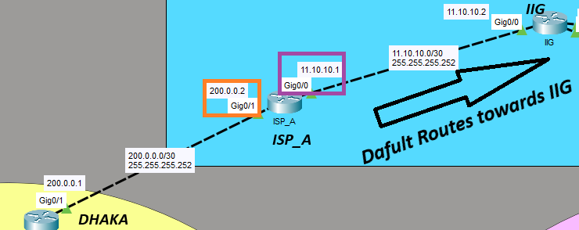
ISP-A Router Commad:
Router>enable
Router#configure terminal
Router(config)#hostname ISP_A
ISP_A(config)#no ip domain-lookup
ISP_A(config)#line console 0
ISP_A(config-line)#exec-timeout 0
ISP_A(config-line)#exit
ISP_A(config)#inter gigabitEthernet 0/1
ISP_A(config-if)#no shutdown
ISP_A(config-if)#ip address 200.0.0.2 255.255.255.252
ISP_A(config-if)#exit
ISP_A(config)#interface gigabitEthernet 0/0
ISP_A(config-if)#no shutdown
ISP_A(config-if)#ip address 11.10.10.1 255.255.255.252
ISP_A(config-if)#exit
#Dafult Routes towards IIG
ISP_A(config)#ip route 0.0.0.0 0.0.0.0 11.10.10.2
Gi0/1: IP 200.0.0.2 with a /30 mask. This is the link to DHAKA (200.0.0.1).
Gi0/0: IP 11.10.10.1 with a /30 mask. This is the link toward IIG, whose side will be 11.10.10.2.
Default route: Anything ISP_A doesn’t know goes to 11.10.10.2 (IIG), so DHAKA’s traffic can continue toward the wider internet.

Slide 35
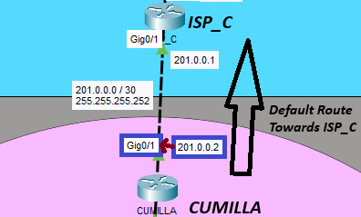
CUMILLA Router Command:
#Give IP in Interface
CUMILLA(config)#interface gigabitEthernet 0/1
CUMILLA(config-if)#no shutdown
CUMILLA(config-if)#ip address 201.0.0.2 255.255.255.252
CUMILLA(config-if)#exit
#Default Route Towards ISP_C
CUMILLA(config)#ip route 0.0.0.0 0.0.0.0 201.0.0.1
Gi0/1: We turned it on and gave it the IP 201.0.0.2 with a /30 mask. This is the link to ISP_C, whose side will be 201.0.0.1.
Default route: Anything CUMILLA doesn’t know goes to 201.0.0.1 (ISP_C). This is how Sw3’s VLANs (192.168.50.0, 60.0, 70.0) will reach other sites and the internet.

Slide 36
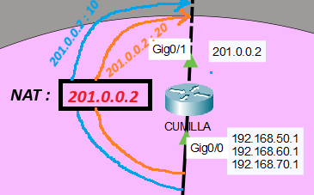
#SetUp NAT(pat)
CUMILLA(config)#access-list 20 permit 192.168.50.0 0.0.0.255
CUMILLA(config)#access-list 20 permit 192.168.60.0 0.0.0.255
CUMILLA(config)#access-list 20 permit 192.168.70.0 0.0.0.255
CUMILLA(config)#ip nat pool pool1 201.0.0.2 201.0.0.2 netmask 255.255.255.252
CUMILLA(config)#ip nat inside source list 20 pool pool1 overload
CUMILLA(config)#interface gigabitEthernet 0/0.10
CUMILLA(config-subif)#ip nat inside
CUMILLA(config-subif)#exit
CUMILLA(config)#interface gigabitEthernet 0/0.20
CUMILLA(config-subif)#ip nat inside
CUMILLA(config-subif)#exit
CUMILLA(config)#interface gigabitEthernet 0/0.30
CUMILLA(config-subif)#ip nat inside
CUMILLA(config-subif)#exit
CUMILLA(config)#interface gigabitEthernet 0/1
CUMILLA(config-if)#ip nat outside
CUMILLA(config-if)#exit
ACL 20: It allows the networks 192.168.50.0, 60.0, and 70.0 (Accounts, Marketing, IT) to use NAT.
NAT pool: pool1 has one public IP, 201.0.0.2, which is CUMILLA’s own Gi0/1 address.
Overload: Many PCs share that one IP, and the router tells them apart by port numbers.
Interfaces: The three subinterfaces (Gi0/0.10, .20, .30) are ip nat inside, and Gi0/1 (toward ISP_C) is ip nat outside.

Slide 37
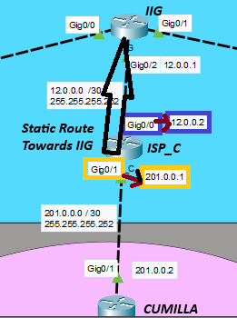
ISP-C Router Command:
#Default Route Towards IIG :
ISP_C(config)#ip route 0.0.0.0 0.0.0.0 12.0.0.1
#Basic Config:
Router>enable
Router#configure terminal
Router(config)#hostname ISP_C
ISP_C(config)#no ip domain-lookup
ISP_C(config)#line con 0
ISP_C(config-line)#exec-timeout 0
ISP_C(config-line)#exit
ISP_C(config)#interface gigabitEthernet 0/1
ISP_C(config-if)#no shutdown
ISP_C(config-if)#ip address 201.0.0.1 255.255.255.252
ISP_C(config-if)#exit
ISP_C(config-if)#interface gigabitEthernet 0/0
ISP_C(config-if)#no shutdown
ISP_C(config-if)#ip address 12.0.0.2 255.255.255.252
ISP_C(config-if)#exit
Basic setup: We named the router ISP_C and turned off DNS lookup and console timeout.
Gi0/1: IP 201.0.0.1 with a /30 mask. This is the link to CUMILLA (201.0.0.2).
Gi0/0: IP 12.0.0.2 with a /30 mask. This is the link toward IIG, whose side will be 12.0.0.1.
Default route: Anything ISP_C doesn’t know goes to 12.0.0.1 (IIG).

Slide 38
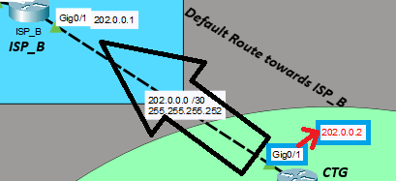
CTG Router Command:
#give ip in Interface :
CTG(config)#interface gigabitEthernet 0/1
CTG(config-if)#no shutdown
CTG(config-if)#ip address 202.0.0.2 255.255.255.252
CTG(config-if)#exit
#Default Route towards ISP_B :
CTG(config)#ip route 0.0.0.0 0.0.0.0 202.0.0.1
Gi0/1: We turned it on and gave it the IP 202.0.0.2 with a /30 mask. This is the link to ISP_B, whose side will be 202.0.0.1.
Default route: Anything CTG doesn’t know goes to 202.0.0.1 (ISP_B). This is how SW4 and SW5’s VLANs (192.168.80.0 and 90.0) will reach other sites and the internet.

Slide 39
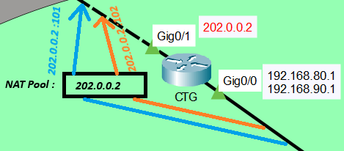
#NAT(PAT) Setup :
CTG(config)#access-list 30 permit 192.168.80.0 0.0.0.255
CTG(config)#access-list 30 permit 192.168.90.0 0.0.0.255
CTG(config)#ip nat pool p1 202.0.0.2 202.0.0.2 netmask 255.255.255.252
CTG(config)#ip nat inside source list 30 pool p1 overload
#Apply in Interface :
CTG(config)#interface gigabitEthernet 0/0.10
CTG(config-subif)#ip nat inside
CTG(config-subif)#exit
CTG(config)#interface gigabitEthernet 0/0.20
CTG(config-subif)#ip nat inside
CTG(config-subif)#exit
CTG(config)#interface gigabitEthernet 0/1
CTG(config-if)#ip nat outside
CTG(config-if)#exit
ACL 30: It allows the networks 192.168.80.0 and 192.168.90.0 (IT and Sales) to use NAT.
NAT pool: p1 has one public IP, 202.0.0.2, which is CTG’s own Gi0/1 address
Overload: Many PCs share that one IP, and the router tells them apart by port numbers.
Interfaces: Gi0/0.10 and Gi0/0.20 are ip nat inside, and Gi0/1 (toward ISP_B) is ip nat outside.

Slide 40
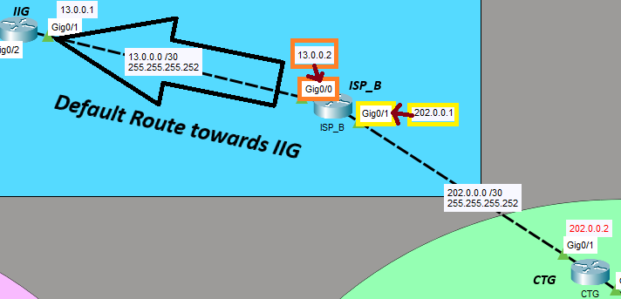
ISP-B Router Command:
#Basic Config:
Router>enable
Router#configure terminal
Router(config)#hostname ISP_B
ISP_C(config)#no ip domain-lookup
ISP_C(config)#line console 0
ISP_C(config-line)#exec-timeout 0
ISP_C(config-line)#exit
#Give Interface IP :
ISP_B(config)#interface gigabitEthernet 0/1
ISP_B(config-if)#no shutdown
ISP_B(config-if)#ip address 202.0.0.1 255.255.255.252
ISP_B(config-if)#exit
ISP_B(config)#interface gigabitEthernet 0/0
ISP_B(config-if)#no shutdown
ISP_B(config-if)#ip address 13.0.0.2 255.255.255.252
ISP_B(config-if)#exit
#Default Route towards IIG
ISP_B(config)#ip route 0.0.0.0 0.0.0.0 13.0.0.1
Gi0/1: IP 202.0.0.1 with a /30 mask. This is the link to CTG (202.0.0.2).
Gi0/0: IP 13.0.0.2 with a /30 mask. This is the link toward IIG, whose side will be 13.0.0.1.
Default route: Anything ISP_B doesn’t know goes to 13.0.0.1 (IIG).

Slide 41
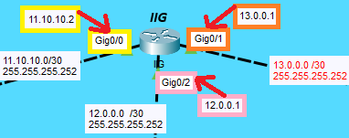
IIG Router Command :
#Basic Config
Router>enable
Router#configure terminal
Router(config)#hostname IIG
IIG(config)#no ip domain-lookup
IIG(config)#line console 0
IIG(config-line)#exec-timeout 0
IIG(config-line)#exit
#Give IP in Interface :
IIG(config)#Interface gigabitEthernet 0/0
IIG(config-if)#no shutdown
IIG(config-if)#ip address 11.10.10.2 255.255.255.252
IIG(config-if)#exit
IIG(config)#Interface gigabitEthernet 0/1
IIG(config-if)#no shutdown
IIG(config-if)#ip address 13.0.0.1 255.255.255.252
IIG(config-if)#exit
IIG(config)#Interface gigabitEthernet 0/2
IIG(config-if)#no shutdown
IIG(config-if)#ip address 12.0.0.1 255.255.255.252
IIG(config-if)#exit
Gi0/0: IP 11.10.10.2 with a /30 mask. This is the link to ISP_A (11.10.10.1).
Gi0/1: IP 13.0.0.1 with a /30 mask. This is the link to ISP_B (13.0.0.2).
Gi0/2: IP 12.0.0.1 with a /30 mask. This is the link to ISP_C (12.0.0.2).

Slide 42
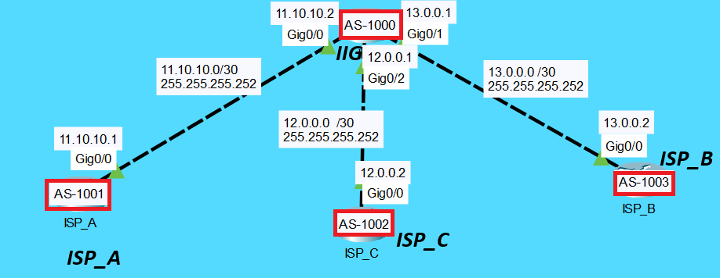
BGP Config:
ISP_A(config)#router bgp 1001
ISP_A(config-router)#network 200.0.0.0 mask 255.255.255.252
ISP_A(config-router)#network 11.10.10.0 mask 255.255.255.252
ISP_A(config-router)#neighbor 11.10.10.2 remote-as 1000
ISP_C(config)#router bgp 1002
ISP_C(config-router)#network 201.0.0.0 mask 255.255.255.252
ISP_C(config-router)#network 12.0.0.0 mask 255.255.255.252
ISP_C(config-router)# neighbor 12.0.0.1 remote-as 1000
ISP_B(config)#router bgp 1003
ISP_B(config-router)#network 202.0.0.0 mask 255.255.255.252
ISP_B(config-router)#network 13.0.0.0 mask 255.255.255.252
ISP_B(config-router)#neighbor 13.0.0.1 remote-as 1000
IIG(config)#router bgp 1000
IIG(config-router)#network 11.10.10.0 mask 255.255.255.252
IIG(config-router)#network 12.0.0.0 mask 255.255.255.252
IIG(config-router)#network 13.0.0.0 mask 255.255.255.252
IIG(config-router)#neighbor 11.10.10.1 remote-as 1001
IIG(config-router)#neighbor 12.0.0.2 remote-as 1002
IIG(config-router)#neighbor 13.0.0.2 remote-as 1003
IIG is AS 1000. It is the center and peers with all three ISPs.
ISP_A is AS 1001, ISP_C is AS 1002, ISP_B is AS 1003. Each ISP peers with IIG (eBGP, because the AS numbers are different).
neighbor ... remote-as: Tells the router who its BGP partner is and which AS it belongs to. Both sides must point to each other.
network: Advertises a network to the partner. Each ISP advertises its customer link (200.0.0.0, 201.0.0.0, 202.0.0.0) and its link to IIG.

Slide 43
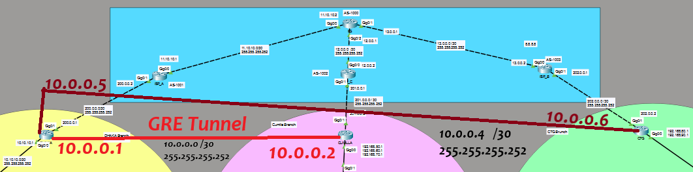
VPN Topology :
VPN Topology :
GRE Tunnel: A private virtual path between branches over the ISP network. It works like a direct cable.
Tunnel IPs: Dhaka-Cumilla uses 10.0.0.0/30. Dhaka-CTG uses 10.0.0.4/30. Dhaka is the hub.
OSPF: OSPF runs over the tunnels. Branches learn each other's LANs automatically.

Slide 44
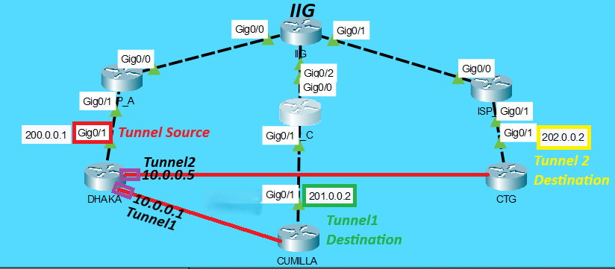
DHAKA Router Command :
#Tunnel with Cumilla:
DHAKA(config)#interface tunnel 1
DHAKA(config-if)#ip address 10.0.0.1 255.255.255.252
DHAKA(config-if)#tunnel mode gre ip
DHAKA(config-if)#tunnel source gigabitEthernet 0/1
DHAKA(config-if)#tunnel destination 201.0.0.2
DHAKA(config-if)#exit
#Tunnel with CTG
DHAKA(config)#interface tunnel 2
DHAKA(config-if)#ip address 10.0.0.5 255.255.255.252
DHAKA(config-if)#tunnel mode gre ip
DHAKA(config-if)#tunnel source gigabitEthernet 0/1
DHAKA(config-if)#tunnel destination 202.0.0.2
DHAKA(config-if)#exit
Tunnel 1: IP 10.0.0.1/30. It goes from DHAKA’s Gi0/1 (200.0.0.1) to CUMILLA’s public IP, 201.0.0.2.
Tunnel 2: IP 10.0.0.5/30. It goes from DHAKA’s Gi0/1 to CTG’s public IP, 202.0.0.2.
GRE: It wraps the private traffic inside normal packets, so the 192.168.x.x LANs can talk across the ISPs as if there were a direct cable between the sites.

Slide 45
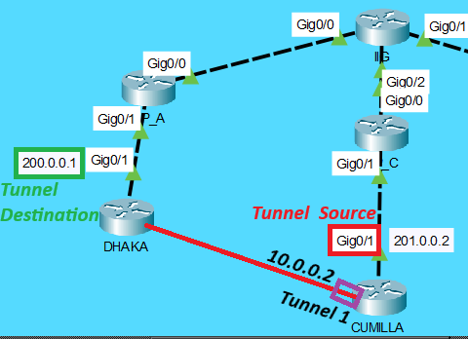
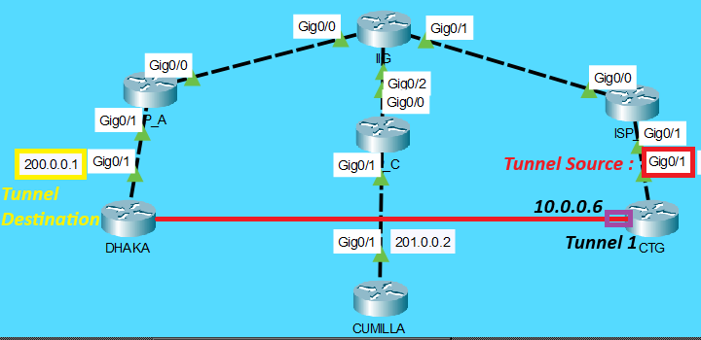
CUMILLA Router Command :
We built the other end of the GRE tunnel on CUMILLA (10.0.0.2, to DHAKA’s 200.0.0.1)
#Tunnrl With Dhaka :
CUMILLA(config)#interface tunnel 1
CUMILLA(config-if)#ip address 10.0.0.2 255.255.255.252
CUMILLA(config-if)#tunnel mode gre ip
CUMILLA(config-if)#tunnel source gigabitEthernet 0/1
CUMILLA(config-if)#tunnel destination 200.0.0.1
CUMILLA(config-if)#exit
CTG Router Command :
#Tunnrl With Dhaka :
CTG(config)#interface tunnel 1
CTG(config-if)#ip address 10.0.0.6 255.255.255.252
CTG(config-if)#tunnel mode gre ip
CTG(config-if)#tunnel source gigabitEthernet 0/1
CTG(config-if)#tunnel destination 200.0.0.1
CTG(config-if)#exit
We built CTG’s end of the GRE tunnel (10.0.0.6, to DHAKA’s 200.0.0.1), which matches DHAKA’s Tunnel 2.

Slide 46
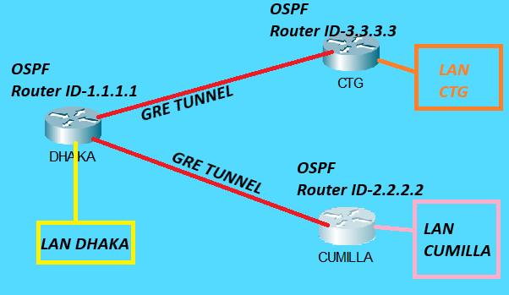
OSPF For Tunnel :
DHAKA(config)#router ospf 1
DHAKA(config-router)#router-id 1.1.1.1
DHAKA(config-router)#network 10.10.10.0 0.0.0.3 area 10
DHAKA(config-router)#network 10.0.0.0 0.0.0.3 area 0
DHAKA(config-router)#network 10.0.0.4 0.0.0.3 area 0
DHAKA(config-router)#redistribute static subnets
CUMILLA(config)#router ospf 2
CUMILLA(config-router)#router-id 2.2.2.2
CUMILLA(config-router)#network 192.168.50.0 0.0.0.255 area 20
CUMILLA(config-router)#network 192.168.60.0 0.0.0.255 area 20
CUMILLA(config-router)#network 192.168.70.0 0.0.0.255 area 20
CUMILLA(config-router)#network 10.0.0.0 0.0.0.3 area 0
CTG(config)#router ospf 3
CTG(config-router)#router-id 3.3.3.3
CTG(config-router)#network 192.168.80.0 0.0.0.255 area 30
CTG(config-router)#network 192.168.90.0 0.0.0.255 area 30
CTG(config-router)#network 10.0.0.4 0.0.0.3 area 0
DHAKA (router-id 1.1.1.1): The tunnels (10.0.0.0/30 and 10.0.0.4/30) are in area 0, and the SW1 link (10.10.10.0/30) is in area 10. redistribute static subnets passes DHAKA’s static routes for 192.168.10/20/30 to the other sites.
CUMILLA (2.2.2.2): Its LANs (192.168.50/60/70) are in area 20, and its tunnel is in area 0.
CTG (3.3.3.3): Its LANs (192.168.80/90) are in area 30, and its tunnel is in area 0.

Slide 47
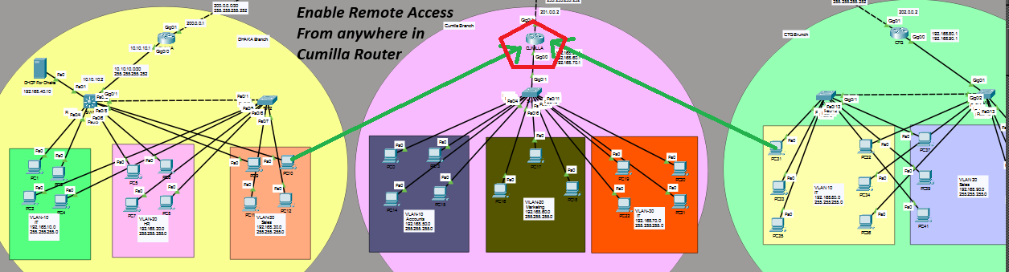
Remote Access:
#SSH Enable in cumilla router :
CUMILLA(config)#ip domain-name cumila.com
CUMILLA(config)#username IT password it123
CUMILLA(config)#crypto key generate rsa
CUMILLA(config)#ip ssh version 2
CUMILLA(config)#enable secret 2222
CUMILLA(config)#line vty 0 15
CUMILLA(config-line)#transport input ssh
CUMILLA(config-line)#login local

Slide 48
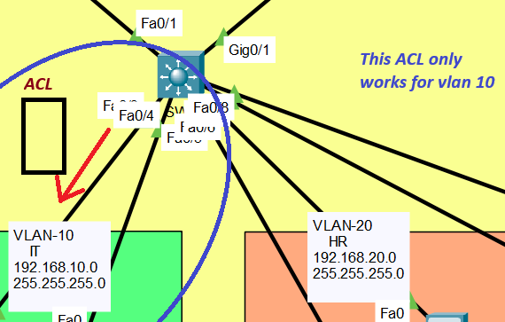
ACL FOR DHAKA (IT) :
Line 1: Allows returning TCP traffic (established) to VLAN 10, such as web replies.
Line 2: Allows ping replies (echo-reply) to VLAN 10.
Line 3: Blocks everything else going to 192.168.10.0/24.
Line 4: Allows all other traffic, so nothing else is affected.
#Create a ACL in SW1:
SW1(config)#access-list 101 permit tcp any 192.168.10.0 0.0.0.255 established
SW1(config)#access-list 101 permit icmp any 192.168.10.0 0.0.0.255 echo-reply
SW1(config)#access-list 101 deny ip any 192.168.10.0 0.0.0.255
SW1(config)#access-list 101 permit ip any any
#Apply This ACL in VLN10:
SW1(config)#interface vlan 10
SW1(config-if)#ip access-group 101 out
SW1(config-if)#exit
SW1
Applied: ip access-group 101 out on interface vlan 10 checks traffic leaving SW1 toward VLAN 10.
Result: VLAN 10 PCs can reach other VLANs and the internet, but others cannot ping or connect to VLAN 10 first.

Slide 49
Conclusion :
What we did: We built a full network for IAS Limited. It has VLANs, DHCP, inter-VLAN routing, NAT, BGP, GRE tunnels, OSPF, SSH and ACL.
Branches: Dhaka, Cumilla and CTG each have their own LANs, and all three are joined by GRE tunnels.
Output: PCs get IP addresses automatically, reach the internet, and can talk to other branches.
Security: SSH protects remote login, and the ACL protects the IT VLAN from outside connections.
Result: One stable, easy-to-manage network that is ready to grow.

Slide 50
Thank you
For your precious time

